Slide 1
Lecture -8
Engineering Mechanics
Centroid
and
Centre of Gravity

Slide 2
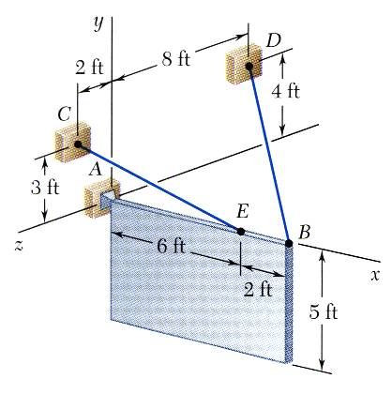
3-D Moment
A sign of uniform density weighs 270 lb and is supported by a ball-and-socket joint at A and by two cables.
Determine the tension in each cable and the reaction at A.

Slide 3
Moment

Slide 4
Moment

Slide 5
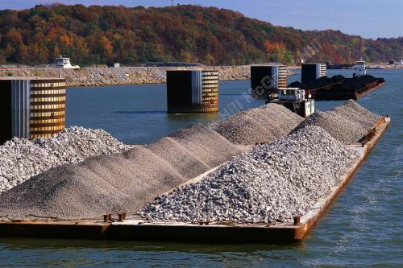
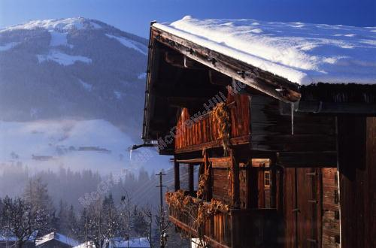
Centre of parallel forces
There are many examples in engineering analysis of distributed loads. It is convenient in some cases to represent such loads as a concentrated force located at the centroid of the distributed load.
Centroid Length of curve
Centroid Area of surface
Centroid Volume of a body
Centre of gravity Gravitational force on a body

Slide 6
Introduction
Up until now we have treated all the forces as concentrated at a point.
Concentred forces don’t exist in practice.
When the area over which the force is being applied is small in comparison with the size of the object, then the assumption of concentrated forces is quite valid.
But, when forces are applied over an area whose dimensions are not negligible compared with the size of the structure, the forces should be treated as distributed and their effect must be included to make our analysis accurate.

Slide 7
Introduction
The earth exerts a gravitational force on each of the particles forming a body – consider how your weight is distributed throughout your body. These forces can be replaced by a single equivalent force equal to the weight of the body and applied at the center of gravity for the body.
The centroid of an area is analogous to the center of gravity of a body; it is the “center of area.” The concept of the first moment of an area is used to locate the centroid.
Determination of the area of a surface of revolution and the volume of a body of revolution are accomplished with the Theorems of Pappus-Guldinus.

Slide 8
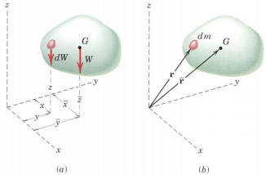
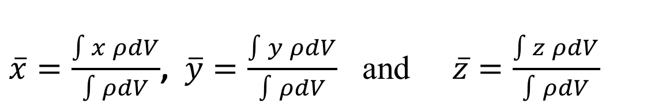
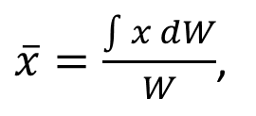
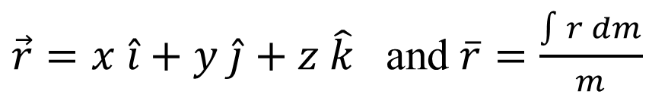
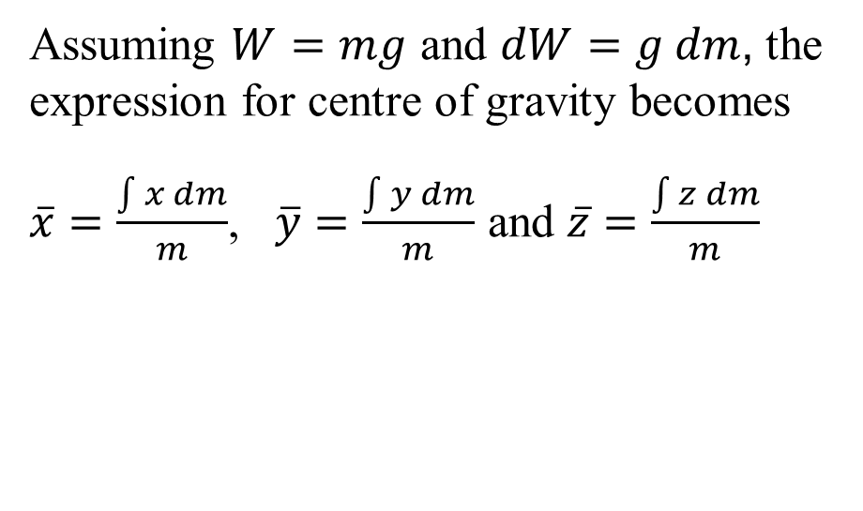
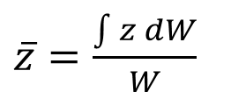
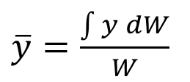
Centre of gravity
$\overline{x}=\frac{\int{x dW}}{W}$,
$\overline{y}=\frac{\int{y dW}}{W}$
$\overline{z}=\frac{\int{z dW}}{W}$
and
Assuming $W=mg$ and $dW=g dm$, the expression for centre of gravity becomes
$\overline{x}=\frac{\int{x dm}}{m}$, $\overline{y}=\frac{\int{y dm}}{m}$ and $\overline{z}=\frac{\int{z dm}}{m}$
$\vec{r}=x \hat{i}+y \hat{j}+z \hat{k}$ and $\overline{r}=\frac{\int{r dm}}{m}$
$\overline{x}=\frac{\int{x ρdV}}{\int{ρdV}}$, $\overline{y}=\frac{\int{y ρdV}}{\int{ρdV}}$ and $\overline{z}=\frac{\int{z ρdV}}{\int{ρdV}}$

Slide 9
Centre of mass Vs. centre of gravity
The weight force W of a body and hence the location of its centre of gravity G is dependent on the acceleration of gravity g. Unless the value of g changes, centre of gravity and centre of mass are same points.
In situations where g varies significantly, the centre of gravity of the body doesn’t coincide with the centre of mass.
For these reasons, it is convenient to locate the centre of mass of a body accurately rather than its centre of gravity.

Slide 10
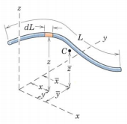
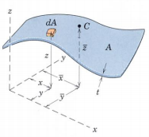
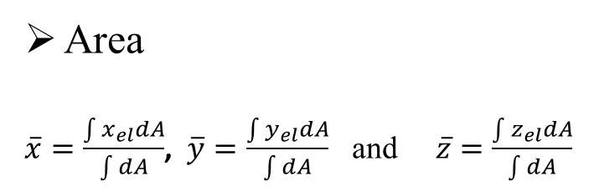
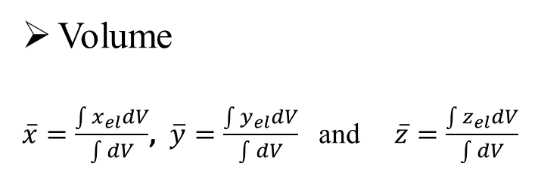
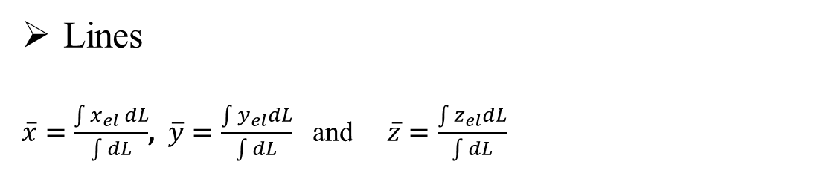
Centroid of lines, areas and volume
Lines
$\overline{x}=\frac{\int{x_{el} dL}}{\int{dL}}$, $\overline{y}=\frac{\int{y_{el}dL}}{\int{dL}}$ and $\overline{z}=\frac{\int{z_{el}dL}}{\int{dL}}$
Area
$\overline{x}=\frac{\int{x_{el}dA}}{\int{dA}}$, $\overline{y}=\frac{\int{y_{el}dA}}{\int{dA}}$ and $\overline{z}=\frac{\int{z_{el}dA}}{\int{dA}}$
Volume
$\overline{x}=\frac{\int{x_{el}dV}}{\int{dV}}$, $\overline{y}=\frac{\int{y_{el}dV}}{\int{dV}}$ and $\overline{z}=\frac{\int{z_{el}dV}}{\int{dV}}$

Slide 11
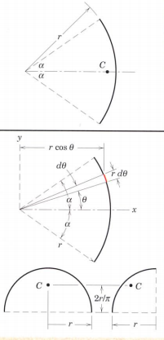
Centroid of lines and area

Slide 12
Centroid of lines and area

Slide 13

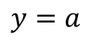
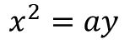
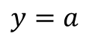
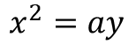
Centroid of lines and area
$$y=a$$
$$x^{2}=ay$$
$$y=a$$
$$x^{2}=ay$$

Slide 14
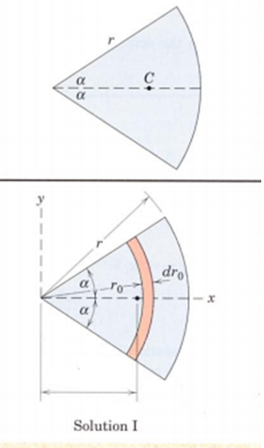
Centroid of lines and area

Slide 15
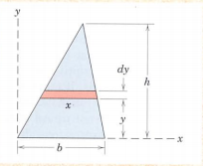
Centroid of lines and area

Slide 16
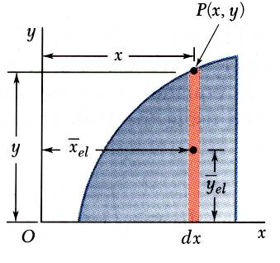
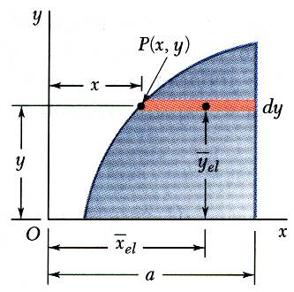
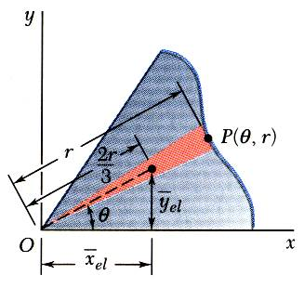
Centroid of areas

Slide 17
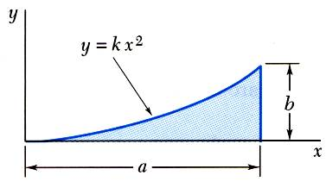
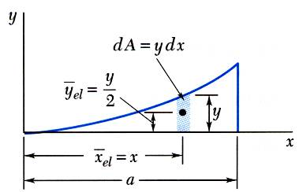
Centroid of areas

Slide 18
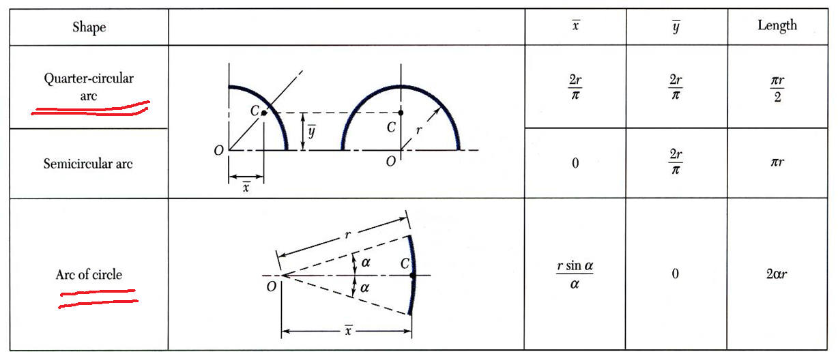
Centroid of length

Slide 19
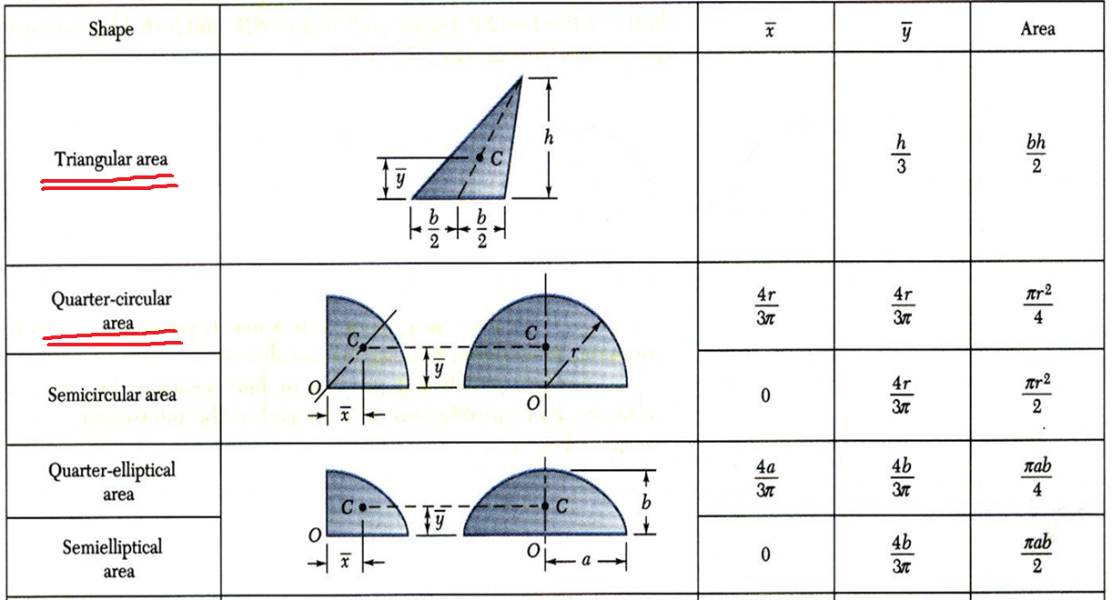
Centroid of areas

Slide 20
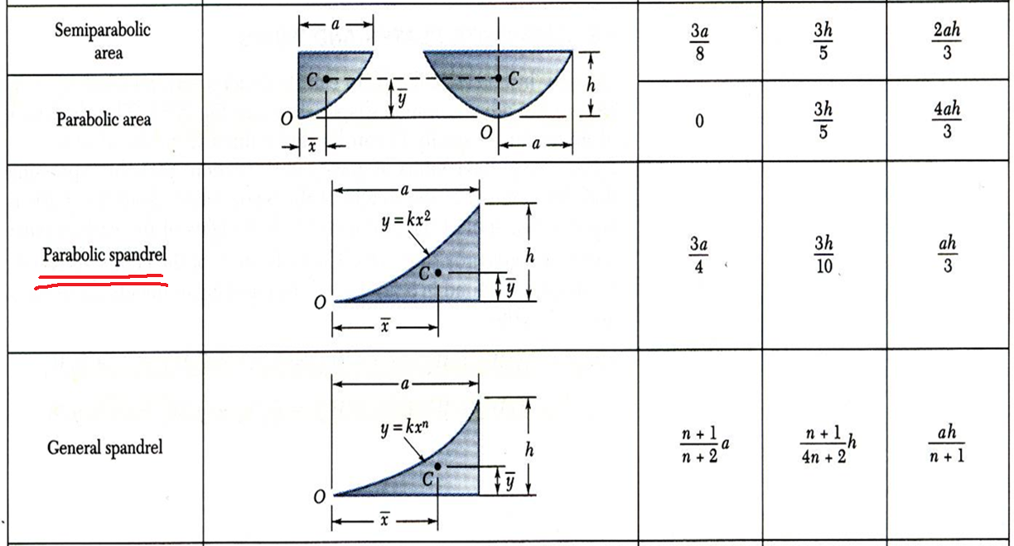
Centroid of areas

Slide 21
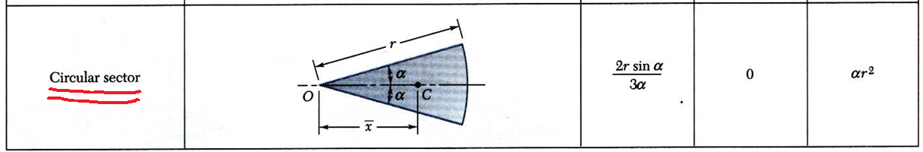
Centroid of areas

Slide 22
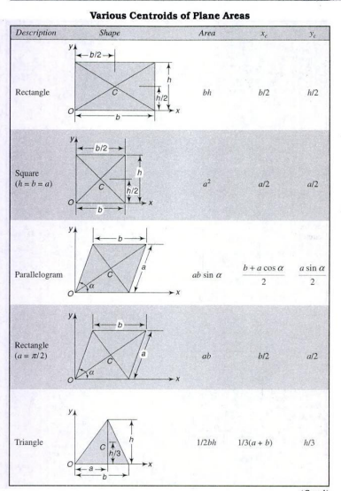
Centroid of areas

Slide 23
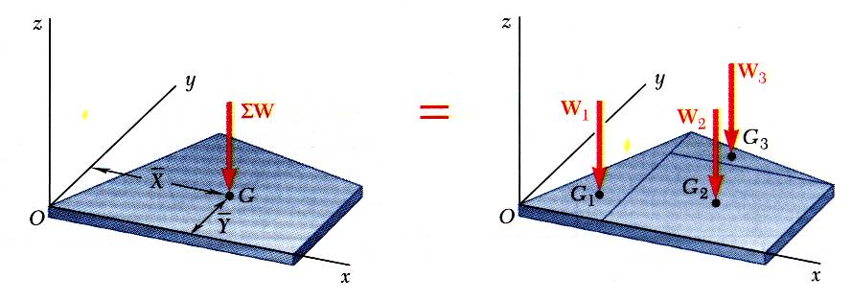
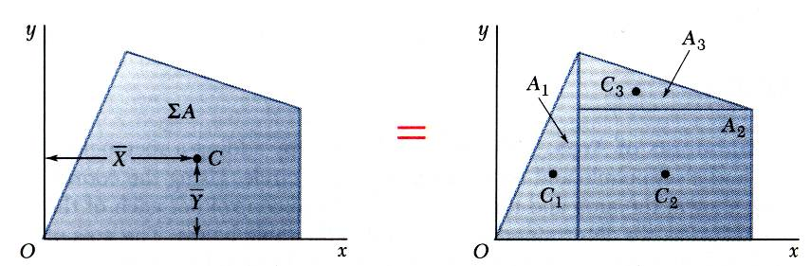
Centre of mass and centroid of composite areas
Composite plates
Composite area

Slide 24
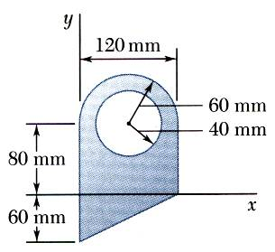
Problem 1: centroid of composite areas

Slide 25
Acknowledgement
NPTEL lectures on Engineering Mechanics
en.wikipedia.org/wiki
britannica.com
Beer & Johnston, Vector Mechanics for Engineers
Meriam & Kraige, Engineering Mechanics
Problems taken from internet sources

